Slide 1
Bronx Community Health Dashboard: Breast Cancer Last Updated: 9/24/2019 See last slide for more information about this project.
While breast cancer can occur among men, it is very rare. This dashboard focuses on breast cancer among women.

Slide 2
Among women, breast cancer is the 2nd leading cause of disability among cancers in the US
Diabetes mellitus, asthma, and depressive
disorders are included for comparison.
Disability-Adjusted Life Years (DALYs) are calculated by adding the Years of Life Lost due to premature mortality in the population and the Years Lost due to Disability for people living with the health condition or its consequences.
Data source: Global Burden of Disease Project, 2017.
Notes:
UPDATED

Slide 3
Breast cancer incidence

Slide 4
Breast cancer rates have increased in the Bronx and New York City overall
Data source: New York State Cancer Registry, 1976-2016.
Notes:
UPDATED

Slide 5
In the Bronx, the breast cancer incidence rate is highest among 70-74 year olds
Data source: New York State Cancer Registry, 2012-2016.
Notes:
UPDATED

Slide 6
In the Bronx, the rate of new breast cancer diagnoses is highest among non-Hispanic white women
Data source: New York State Cancer Registry, 2012-2016.
Notes:
UPDATED

Slide 7
In the Bronx, breast cancer rates remain highest among non-Hispanic white women
Data source: New York State Cancer Registry, 1992-2016.
Rates are age-adjusted to the 2000 US Std million (19 age groups) standard.
Notes:
AB done

Slide 8
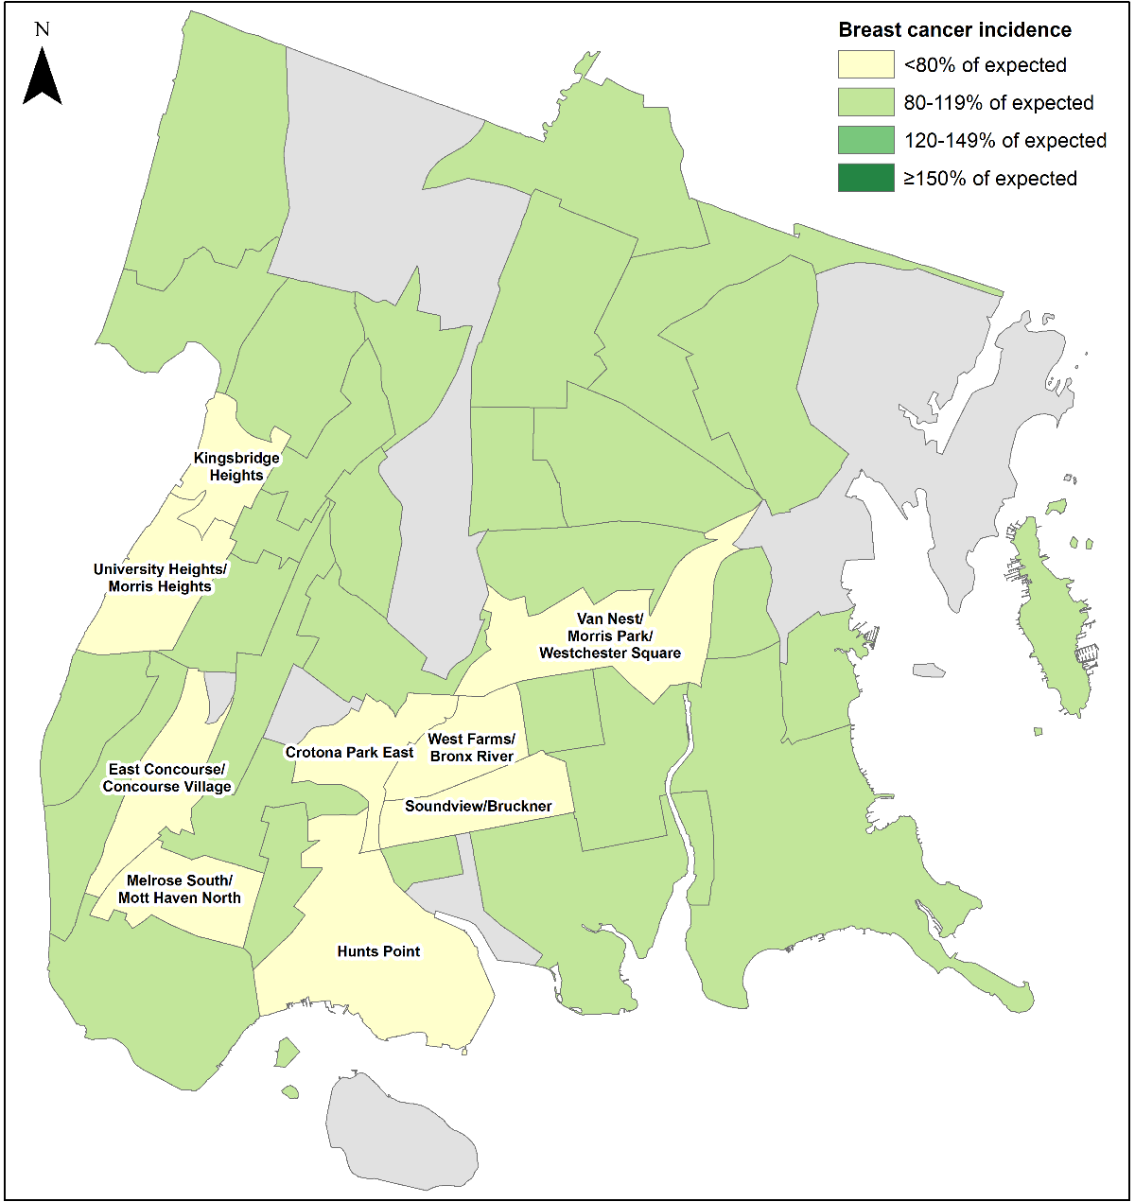
The incidence of breast cancer is about as expected in most of the Bronx, with incidence rates less than expected in certain neighborhoods
Data source: NY State Cancer Registry, 2010-2014
Data is presented at the Neighborhood Tabulation Area (NTA)-level and is age-adjusted.

Slide 9
Mortality from breast cancer

Slide 10
While the incidence of breast cancer has increased since 1976, breast cancer mortality has declined
Data source: New York State Cancer Registry, 1976-2016.
Notes:
UPDATED

Slide 11
In the Bronx, the mortality rate from breast cancer is highest among 85+ year olds
Data source: New York State Cancer Registry, 2012-2016.
Notes:
UPDATED

Slide 12
In the Bronx, the mortality rate from breast cancer is highest among non-Hispanic white and black women
Data source: New York State Cancer Registry, 2012-2016.
Notes:
UPDATED

Slide 13
In the Bronx, mortality rates from breast cancer have decreased among all race/ethnicity groups
Data source: New York State Cancer Registry, 1992-2016.
Rates are age-adjusted to the 2000 US Std million (19 age groups) standard.
Notes:
AB done

Slide 14
Risk factors & protective factors

Slide 15
Potential risk factors for which there is strong evidence of an association with breast cancer and data available for the Bronx
Increases risk
Obesity or high BMI (among post-menopausal women only)
Heavy alcohol consumption
First pregnancy over the age of 30
Greater birth weight
Decreases risk
Exercising (particularly vigorous exercise)
Breastfeeding
Data source: World Cancer Research Fund International—Diet, Nutrition, Physical Activity and Breast Cancer 2018.
Notes:
UPDATED

Slide 16
The prevalence of obesity among adults is highest in the Bronx and increasing at a higher rate than in other boroughs
A BMI of 30 or greater is classified as obese
The association between obesity and breast cancer depends on menopausal status; it is a risk factor among post-menopausal women only
Data source: Community Health Survey, 2002-2017.
Body Mass Index (BMI) is calculated based on respondents’ self-reported weight and height.
Notes:
UPDATED

Slide 17
The percent of adults who drink heavily is relatively stable in the Bronx
Data source: Community Health Survey, 2002-2017.
Heavy drinking is defined as an average of more than 2 drinks per day for men and more than 1 drink per day for women.
Notes:
UPDATED

Slide 18
The percent of adults who exercised in the past 30 days remains lowest in the Bronx, with minimal improvement
Data source: Community Health Survey, 2002-2017.
Notes:
UPDATED

Slide 19
Average age of first birth is substantially lower in the Bronx than the rest of NYC, but it is increasing
Later age of first birth is associated with an increased risk of breast cancer, though not having any children is a stronger risk factor.
0
Data source: CDC Wonder Births Data, 2003-2017.
Notes:
UPDATED

Slide 20
The percent of total births with high birth weight is relatively stable in the Bronx
Data source: CDC Wonder Births Data, 2007-2017.
High birth weight defined as > 4,500 g at any given gestational age.
Notes:
UPDATED

Slide 21
The percent of women exclusively breastfeeding is lowest in the Bronx and relatively unchanged
Data source: New York City Vital Statistics Birth Data, 2008-2016.
Notes:
UPDATED

Slide 22
Potential risk factors for which there is strong evidence of an association with breast cancer, but no high-quality data is available for the Bronx
Increases risk
Early menarche (before the age of 12)
Late natural menopause (after the age of 55)
Ionizing radiation exposure from medical imaging, particularly during puberty
Hormone therapy (containing estrogen with or without progesterone)—the risk is greater with combined estrogen plus progesterone preparations
Oral contraceptives containing both estrogen and progesterone cause a small increased risk in young women, among current and recent users only
Decreases risk
Bearing children
Data source: World Cancer Research Fund International—Diet, Nutrition, Physical Activity and Breast Cancer 2018.
Notes:
UPDATED – no change

Slide 23
About the Community Health Dashboard Project
The goal of the project is to provide Bronx-specific data on risk factors and health outcomes with an emphasis on presenting data on trends, socio-demographic differences (e.g., by age, sex, race/ethnicity, etc.) and sub-county/neighborhood level data
Data will be periodically updated as new data becomes available.
Produced by Montefiore’s Office of Community & Population Health using publicly-available data sources
For more information please contact us at OCPHDept@montefiore.org

