Slide 1
Bronx Community Health Dashboard: Colorectal Cancer Last Updated: 9/24/2019 See last slide for more information about this project.

Slide 2
Colorectal cancer is the 2nd leading cause of disability among cancers in New York State
Diabetes mellitus, asthma, and depressive
disorders are included for comparison.
Disability-Adjusted Life Years (DALYs) are calculated by adding the Years of Life Lost due to premature mortality in the population and the Years Lost due to Disability for people living with the health condition or its consequences.
Data source: Global Burden of Disease Project, 2017.
Notes:
UPDATED

Slide 3
Colorectal cancer incidence

Slide 4
Colorectal cancer rates have decreased among both sexes, but remain higher for men
Data source: New York State Cancer Registry, 1976-2016.
Notes:
UPDATED

Slide 5
In the Bronx, the colorectal cancer rate is highest amongst men who are 80-84 years old
Data source: New York State Cancer Registry, 2012-2016.
Notes:
UPDATED

Slide 6
In the Bronx, the colorectal cancer rate is slightly higher among non-Hispanic white men
Data source: New York State Cancer Registry, 2012-2016.
Notes:
UPDATED

Slide 7
In the Bronx, colorectal cancer rates have decreased among all race/ethnicity groups
Data source: New York State Cancer Registry, 1990-2016.
Rates are age-adjusted to the 2000 US Std million (19 age groups) standard.
Notes:
UPDATED

Slide 8
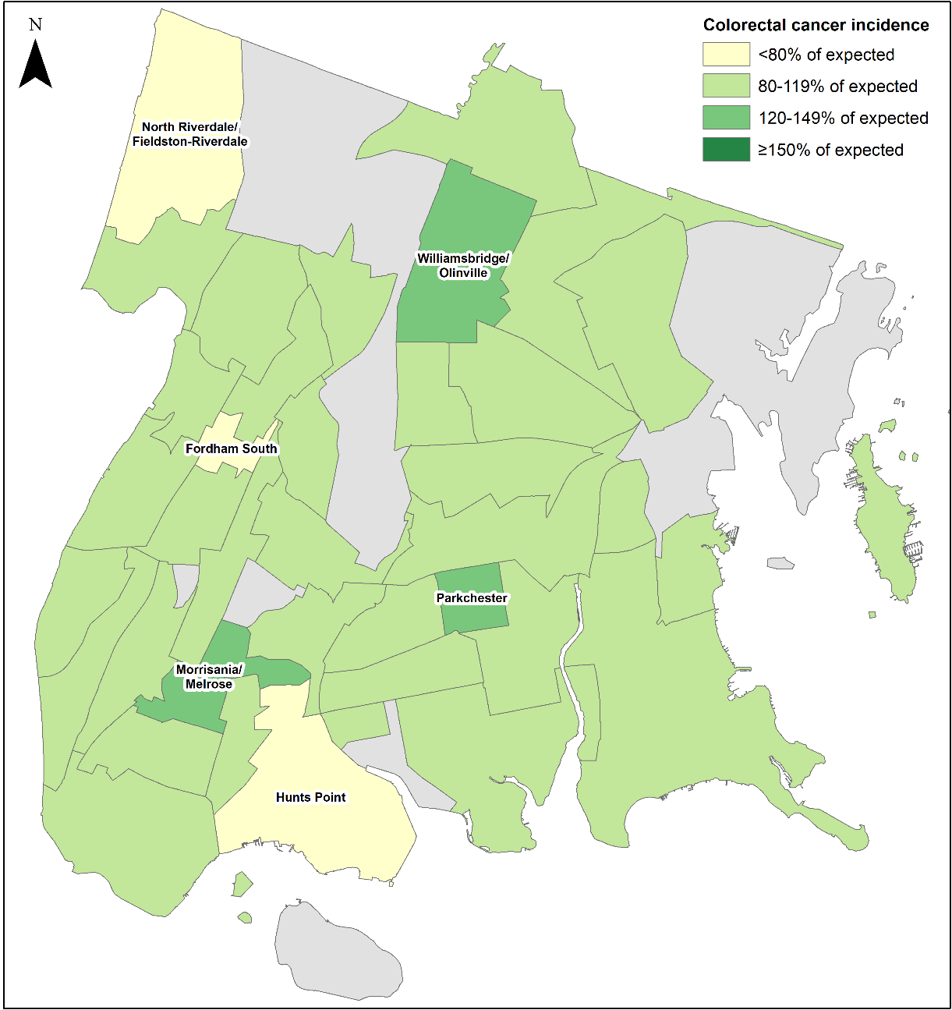
The incidence of colorectal cancer is about as expected in most of the Bronx, with incidence below and above expected in a few neighborhoods
Data source: NY State Cancer Registry, 2010-2014
Data is presented at the Neighborhood Tabulation Area (NTA)-level and is age- and sex-adjusted.
Notes:
To Be Done Later

Slide 9
Mortality from colorectal cancer

Slide 10
Mortality rates from colorectal cancer have declined for both sexes; differences between the Bronx and NYC overall have declined
Data source: New York State Cancer Registry, 1976-2016.
Notes:
UPDATED

Slide 11
In the Bronx, the mortality rate from colorectal cancer is highest among 85+ year old men
Data source: New York State Cancer Registry, 2012-2016.
Notes:
UPDATED

Slide 12
In the Bronx, the mortality rate from colorectal cancer is highest among non-Hispanic white men
Data source: New York State Cancer Registry, 2012-2016.
Notes:
UPDATED

Slide 13
In the Bronx, mortality rates from colorectal cancer have decreased among all race/ethnicity groups
Data source: New York State Cancer Registry, 1990-2016.
Rates are age-adjusted to the 2000 US Std million (19 age groups) standard.
Notes:
UPDATED

Slide 14
Risk factors & protective factors

Slide 15
Potential risk factors for which there is strong evidence of an association with colorectal cancer and data available for the Bronx
Increases risk
High BMI/obesity
Heavy alcohol use
Smoking
Decreases risk
Colorectal cancer screening
Physical activity
Though not included in the Colorectal Cancer Report 2017, randomized trials of colorectal cancer screening have shown that a biennial guaiac-based faecal occult blood test has the potential to reduce mortality by about 25% in those accepting screening.
Source: Logan RFA, Patnick J, Nickerson C on behalf of the English Bowel Cancer Screening Evaluation Committee, et al. Outcomes of the Bowel Cancer Screening Programme (BCSP) in England after the first 1 million tests. Gut 2012;61:1439-1446.
Data source: World Cancer Research Fund International—Diet, Nutrition, Physical Activity and Colorectal Cancer 2018.
Notes:
UPDATED
https://www.wcrf.org/sites/default/files/Colorectal-cancer-report.pdf

Slide 16
The prevalence of obesity among adults has stabilized in most boroughs but continues to increase in the Bronx
A BMI of 30 or greater is classified as obese
Data source: Community Health Survey, 2002-2017.
Body Mass Index (BMI) is calculated based on respondents’ self-reported weight and height.
Notes:
UPDATED

Slide 17
The percent of adults who drink heavily has increased since 2002 in all boroughs, except the Bronx and Staten Island
Data source: Community Health Survey, 2002-2017.
Heavy drinking is defined as an average of more than 2 drinks per day for men and more than 1 drink per day for women.
Notes:
UPDATED

Slide 18
The percent of current adult smokers across New York City has fallen since 2002, but remains highest for Staten Island
Data source: Community Health Survey, 2002-2017.
Staten Island 2010 data is likely an underestimate and 2011/2017 is likely an overestimate of the true prevalence of smoking due to random sampling variation.
Notes:
UPDATED

Slide 19
The percent of adults who get timely colon cancer screening across New York City has increased since 2002, and remains highest in Manhattan
Data source: Community Health Survey, 2002-2017.
Results restricted to adults aged 50 and older. Timely colon cancer screening defined as having had a colonoscopy in the past 10 years.
Notes:
UPDATED

Slide 20
The percent of adults who exercised in the past 30 days remains lowest in the Bronx
Data source: Community Health Survey, 2002-2017.
Notes:
UPDATED

Slide 21
Potential risk factors for which there is strong evidence of an association with colorectal cancer, but no data available for the Bronx
Increases risk
Processed meat
Red meat
Ulcerative colitis or Crohn’s disease
Decreases risk
Whole grains
Dietary fiber
Dairy products
Calcium supplements
Aspirin use
Hormone therapy in postmenopausal women
Data source: World Cancer Research Fund International—Diet, Nutrition, Physical Activity and Colorectal Cancer 2018.
Notes:
UPDATED

Slide 22
About the Community Health Dashboard Project
The goal of the project is to provide Bronx-specific data on risk factors and health outcomes with an emphasis on presenting data on trends, socio-demographic differences (e.g., by age, sex, race/ethnicity, etc.) and sub-county/neighborhood level data
Data will be periodically updated as new data becomes available.
Produced by Montefiore’s Office of Community & Population Health using publicly-available data sources
For more information please contact us at OCPHDept@montefiore.org

