Slide 1
Bronx Community Health Dashboard: Housing and Health Last Updated: 1/29/2019 See end of presentation for more information about this project and links to data sources.

Slide 2
Housing and health: lead
Tested for lead | Elevated blood lead levels

Slide 3
The percent of children tested for lead by age 3 years remains the highest in the Bronx
Children younger than 6 years have the most rapidly developing nervous systems, making them particularly vulnerable to lead poisoning.
Lead poisoning can cause seizures, developmental delay, hyperactivity, behavioral disorders, hearing loss, and anemia. Even low blood lead levels can have long-term effects on a child’s IQ.
Data sources: New York City Bureau of Vital Statistics, New York City Healthy Homes Program (2008-2016), data from New York City DOHMH Environment & Health Data Portal

Slide 4
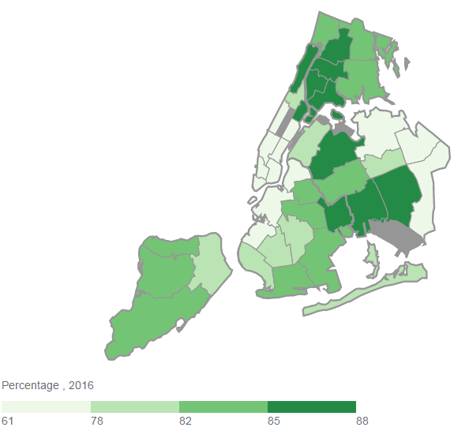
More than 85% of children in the Bronx have been tested for lead
Crotona - Tremont
Fordham – Bronx Pk
High Bridge - Morrisania
Hunts Point – Mott Haven
Kingsbridge - Riverdale
Northeast Bronx
Pelham – Throgs Neck
5
2
6
3
1
7
4
It is important for children at risk of exposure to undergo blood tests for lead, as many people with lead poisoning show mild symptoms or even no symptoms at all. Lead testing is the first step towards eliminating lead from a child’s environment.
Data source: New York City Bureau of Vital Statistics, New York City Healthy Homes Program (2016), data from New York City DOHMH Environment & Health Data Portal

Slide 5
Rates of elevated blood lead levels among children less than 6 have declined in all 5 NYC boroughs (among those tested)
It is important for children at risk of exposure to undergo blood tests for lead, as many people with lead poisoning show mild symptoms or even no symptoms at all. Lead testing is the first step towards eliminating lead from a child’s environment.
Data source: New York City Healthy Homes Program (2005-2016), data from New York City DOHMH
Environment & Health Data Portal; Blood lead levels of 15 mcg/dL or greater are considered elevated.

Slide 6
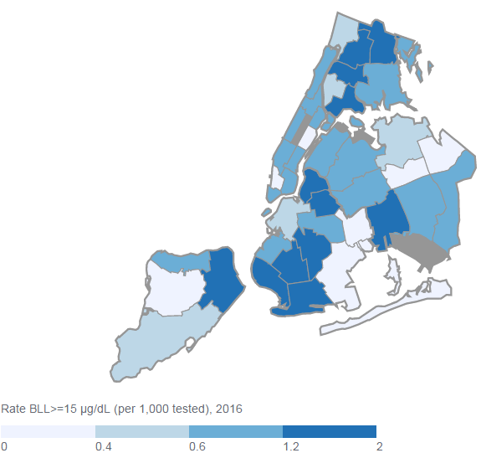
Rates of elevated blood lead levels among tested children less than 6 years old are highest in Fordham–Bronx Pk and Northeast Bronx
Crotona - Tremont
Fordham – Bronx Pk
High Bridge - Morrisania
Hunts Point – Mott Haven
Kingsbridge - Riverdale
Northeast Bronx
Pelham – Throgs Neck
5
2
6
3
1
7
4
Data source: New York City Healthy Homes Program (2016), data from New York City DOHMH
Environment & Health Data Portal

Slide 7
Housing and health: other hazards
Homes with mice or rats | Homes with cockroaches | Homes with mold | Homes with leaks | Homes with 3 or more maintenance deficiencies

Slide 8
More homes had mice or rats in the Bronx than any other NYC borough
Exposure to mice or rats in the home increases risk of developing asthma and exacerbating established asthma.
Data source: New York City Housing and Vacancy Survey (1999-2014), data from New York City DOHMH
Environment & Health Data Portal

Slide 9
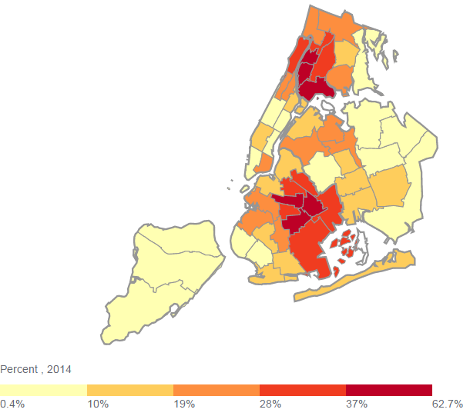
Within the Bronx, University Heights/Fordham is the sub-borough with the highest percent of homes with mice or rats in the building
Highbridge/South Concourse
Kingsbridge Heights/Mosholu
Morrisania/East Tremont
Mott Haven/Hunts Point
Pelham Parkway
Riverdale/Kingsbridge
Soundview/Parkchester
Throgs Neck/Co-op City
University Heights/Fordham
Williamsbridge/Baychester
6
2
10
2
9
5
9
3
103
1
3
8
102
7
4
7
Data source: New York City Housing and Vacancy Survey (2014), data from New York City DOHMH
Environment & Health Data Portal

Slide 10
The percent of homes with cockroaches has decreased in all 5 NYC boroughs since 2008; and remains highest in the Bronx
Exposure to cockroaches in the home increases risk of asthma development or exacerbation.
Data source: New York City Housing and Vacancy Survey (2008-2014), data from New York City DOHMH
Environment & Health Data Portal

Slide 11
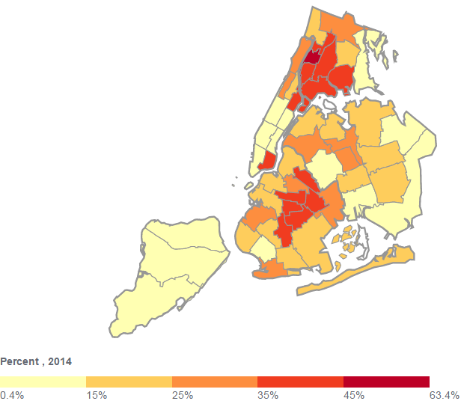
Within the Bronx, University Heights/Fordham is the sub-borough with the highest percent of homes with cockroaches
6
10
Highbridge/South Concourse
Kingsbridge Heights/Mosholu
Morrisania/East Tremont
Mott Haven/Hunts Point
Pelham Parkway
Riverdale/Kingsbridge
Soundview/Parkchester
Throgs Neck/Co-op City
University Heights/Fordham
Williamsbridge/Baychester
101
2
2
9
5
101
103
3
1
3
8
103
7
4
4
Data source: New York City Housing and Vacancy Survey (2014), data from New York City DOHMH
Environment & Health Data Portal

Slide 12
More adults report mold in their home in the Bronx than any other NYC borough
Data source: New York City Community Health Survey (2012), data from New York City DOHMH
Environment & Health Data Portal

Slide 13
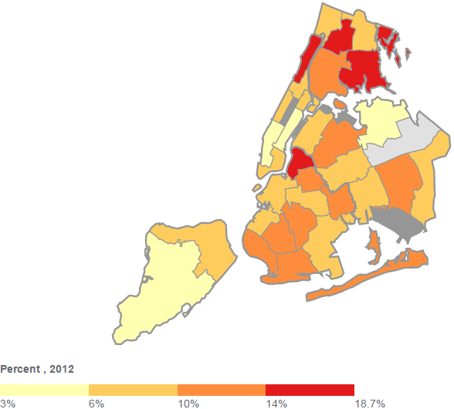
Within the Bronx, Fordham–Bronx Park is the United Hospital Fund neighborhood with the highest percent of adults reporting mold in the home
2
Fordham – Bronx Pk
Kingsbridge – Riverdale
Northeast Bronx
Pelham – Throgs Neck
South Bronx
1
3
9
102
4
5
103
102
4
7
1
104
1
Data source: New York City Community Health Survey (2012), data from New York City DOHMH
Environment & Health Data Portal

Slide 14
The percent of homes with leaks remains highest in the Bronx
Leaks can lead to mold.
Data source: New York City Housing and Vacancy Survey (1999-2014), data from New York City DOHMH
Environment & Health Data Portal

Slide 15
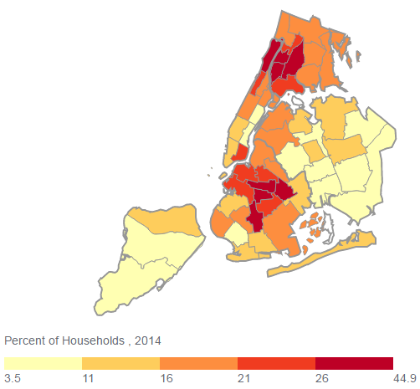
Within the Bronx, Highbridge/South Concourse is the sub-borough with the highest percent of homes with leaks
Highbridge/South Concourse
Kingsbridge Heights/Mosholu
Morrisania/East Tremont
Mott Haven/Hunts Point
Pelham Parkway
Riverdale/Kingsbridge
Soundview/Parkchester
Throgs Neck/Co-op City
University Heights/Fordham
Williamsbridge/Baychester
6
10
4
2
9
3
5
1
7
8
4
Data source: New York City Housing and Vacancy Survey (2014), data from New York City DOHMH
Environment & Health Data Portal

Slide 16
The percent of homes with 3 or more maintenance deficiencies remains highest in the Bronx
Maintenance deficiencies include any of the following:
Heating equipment malfunction
Supplemental heat required
Presence of mice or rats
Cracks/holes in interior walls/ceilings
Floor holes
Broken plaster and peeling paint
Water leakage
Data source: New York City Housing and Vacancy Survey (1999-2014), data from New York City DOHMH
Environment & Health Data Portal

Slide 17
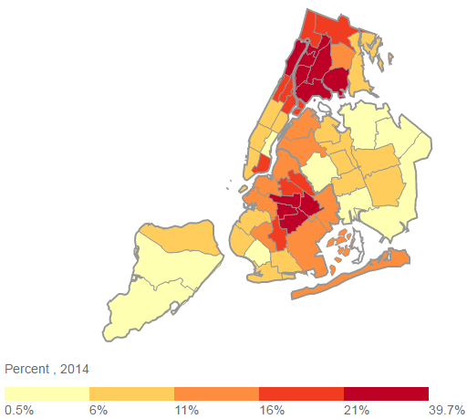
Within the Bronx, Highbridge/South Concourse is the sub-borough with the highest percent of homes with 3 or more maintenance deficiencies
Highbridge/South Concourse
Kingsbridge Heights/Mosholu
Morrisania/East Tremont
Mott Haven/Hunts Point
Pelham Parkway
Riverdale/Kingsbridge
Soundview/Parkchester
Throgs Neck/Co-op City
University Heights/Fordham
Williamsbridge/Baychester
6
10
4
2
5
9
3
8
1
7
4
Data source: New York City Housing and Vacancy Survey (2014), data from New York City DOHMH
Environment & Health Data Portal

Slide 18
More than two-thirds of Bronx renter-occupied units have at least one maintenance deficiency
Data source: New York City Housing and Vacancy Survey (2014), data from New York City DOHMH
Environment & Health Data Portal

Slide 19
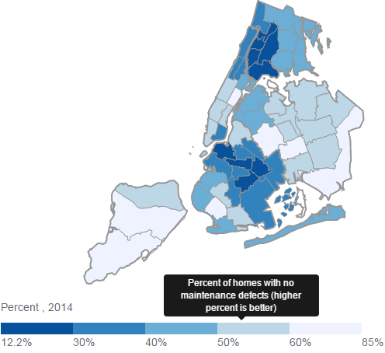
Within the Bronx, Throgs Neck/Co-op City is the sub-borough with the highest percent of renter-occupied homes with no maintenance deficiencies
Highbridge/South Concourse
Kingsbridge Heights/Mosholu
Morrisania/East Tremont
Mott Haven/Hunts Point
Pelham Parkway
Riverdale/Kingsbridge
Soundview/Parkchester
Throgs Neck/Co-op City
University Heights/Fordham
Williamsbridge/Baychester
6
2
10
4
9
3
5
1
7
8
4
Data source: New York City Housing and Vacancy Survey (2014), data from New York City DOHMH
Environment & Health Data Portal

Slide 20
The percent of homes using supplemental heat has increased in all 5 NYC boroughs; and remains highest in the Bronx
Examples of supplemental heat include space heaters or using the oven for heat
Exposure to supplemental heat in the home may increase risk of development or exacerbation of asthma.
Data source: New York City Housing and Vacancy Survey (1999-2014), data from New York City DOHMH
Environment & Health Data Portal

Slide 21
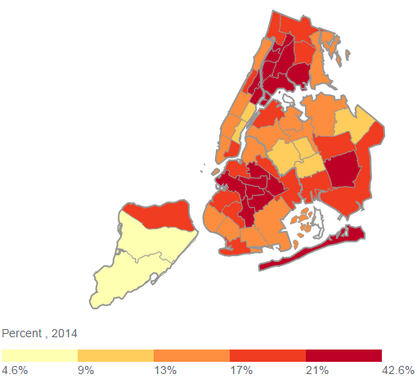
Within the Bronx, University Heights/Fordham is the sub-borough with the highest percent of homes using supplemental heat
Highbridge/South Concourse
Kingsbridge Heights/Mosholu
Morrisania/East Tremont
Mott Haven/Hunts Point
Pelham Parkway
Riverdale/Kingsbridge
Soundview/Parkchester
Throgs Neck/Co-op City
University Heights/Fordham
Williamsbridge/Baychester
6
10
2
2
2
4
1
4
9
3
5
1
9
102
1
8
4
7
4
5
5
103
102
4
4
7
1
104
1
Data source: New York City Housing and Vacancy Survey (2014), data from New York City DOHMH
Environment & Health Data Portal

Slide 22
Housing and health: exposure to tobacco smoke
Exposed to secondhand smoke within the home (children) | Exposed to secondhand smoke within the home (adults)

Slide 23
The Bronx has the second highest percent of children who are exposed to any second-hand smoke in the home
Bronx only
Data source: New York City Child Health, Emotional Wellness and Development Survey, 2015
* Estimate for Staten Island is unreliable due to small numbers.

Slide 24
Despite the Bronx not having the highest smoking prevalence, the percent of adults reporting second-hand smoke is highest in the Bronx compared to other NYC boroughs
Exposure to second-hand smoke in the home is a risk factor for asthma and lung cancer.
Data source: New York City Community Health Survey (2004-2012), data from New York City DOHMH
Environment & Health Data Portal

Slide 25
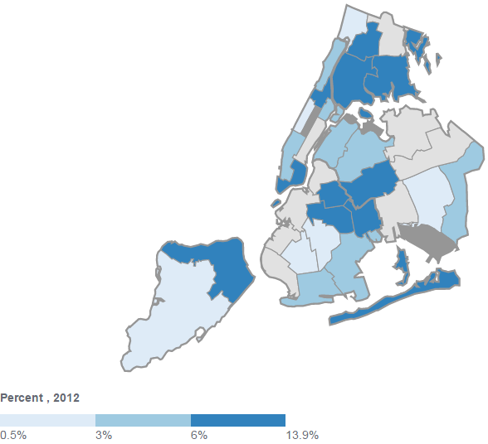
Within the Bronx, South Bronx is the United Hospital Fund neighborhood with the highest percent of adults reporting second-hand smoke in the home
2
Fordham – Bronx Pk
Kingsbridge - Riverdale
4 Pelham – Throgs Neck
5 South Bronx
2
4
1
1
9
102
4
5
4
5
103
102
4
7
1
104
1
Data source: New York City Community Health Survey (2012), data from New York City DOHMH
Environment & Health Data Portal

Slide 26
Housing and health: crowding, affordability and stable housing
Did not have a regular place to live (children) | Homes with crowding | Owner-occupied homes | Rental Burden

Slide 27
More children did not have a regular place to live in the prior year in the Bronx than any other NYC borough
Regular place to live does not include living in a family shelter, public place, car or abandoned building or temporarily living with family or friends.
Data source: New York City Child Health, Emotional Wellness and Development Survey, 2015
* Estimates for Manhattan, Queens, and Staten Island are potentially unreliable due to small numbers.

Slide 28
The Bronx has the highest percent of households with crowding
Data source: American Community Survey (2011-2015), data from New York City DOHMH
Environment & Health Data Portal

Slide 29
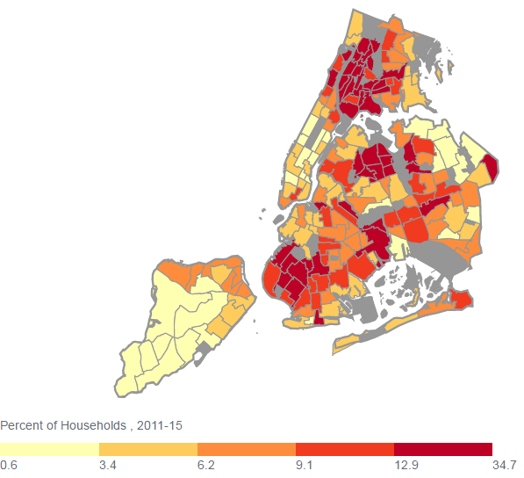
Within the Bronx, Fordham South is the neighborhood tabulation area with the highest percent of crowded homes
4
Data source: American Community Survey (2011-15), data from New York City DOHMH
Environment & Health Data Portal

Slide 30
The Bronx has the lowest percent of owner-occupied homes, which suggests housing instability
Data source: American Community Survey (2011-15), data from New York City DOHMH
Environment & Health Data Portal

Slide 31
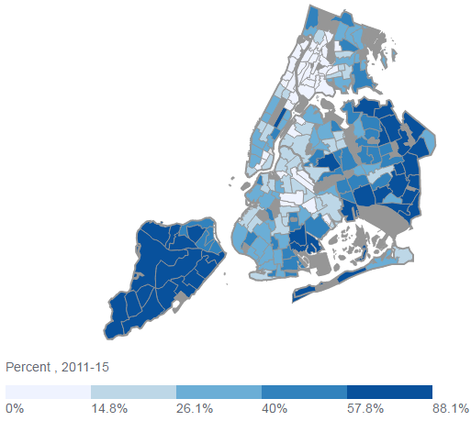
Within the Bronx, Fordham South, West Concourse and Mount Hope have the lowest rates of home–ownership
4
Data source: American Community Survey (2011-15), data from New York City DOHMH
Environment & Health Data Portal

Slide 32
Since 2005, the percent of Bronx residents with severe rental burden has slightly increased
Severe rental burden defined as spending ≥50% of pre-tax household income on rent
Data source: American Community Survey

Slide 33
Over one-third of Bronx residents have severe rental burden, with female and minority residents more likely to have a severe burden
Severe rental burden defined as spending ≥50% of pre-tax household income on rent
------------------------------Bronx Only----------------------------------
While Staten Island has the highest rental burden, it also has the lowest proportion of residents who rent (22% vs. 70% in the Bronx)
Data source: IPUMS-USA, University of Minnesota, 2016 ACS 5-year estimates

Slide 34
In the Bronx, children and those living below the FPL are more likely to have severe rental burden
Severe rental burden defined as spending ≥50% of pre-tax household income on rent
Age
Data source: IPUMS-USA, University of Minnesota, 2016 ACS 5-year estimates

Slide 35
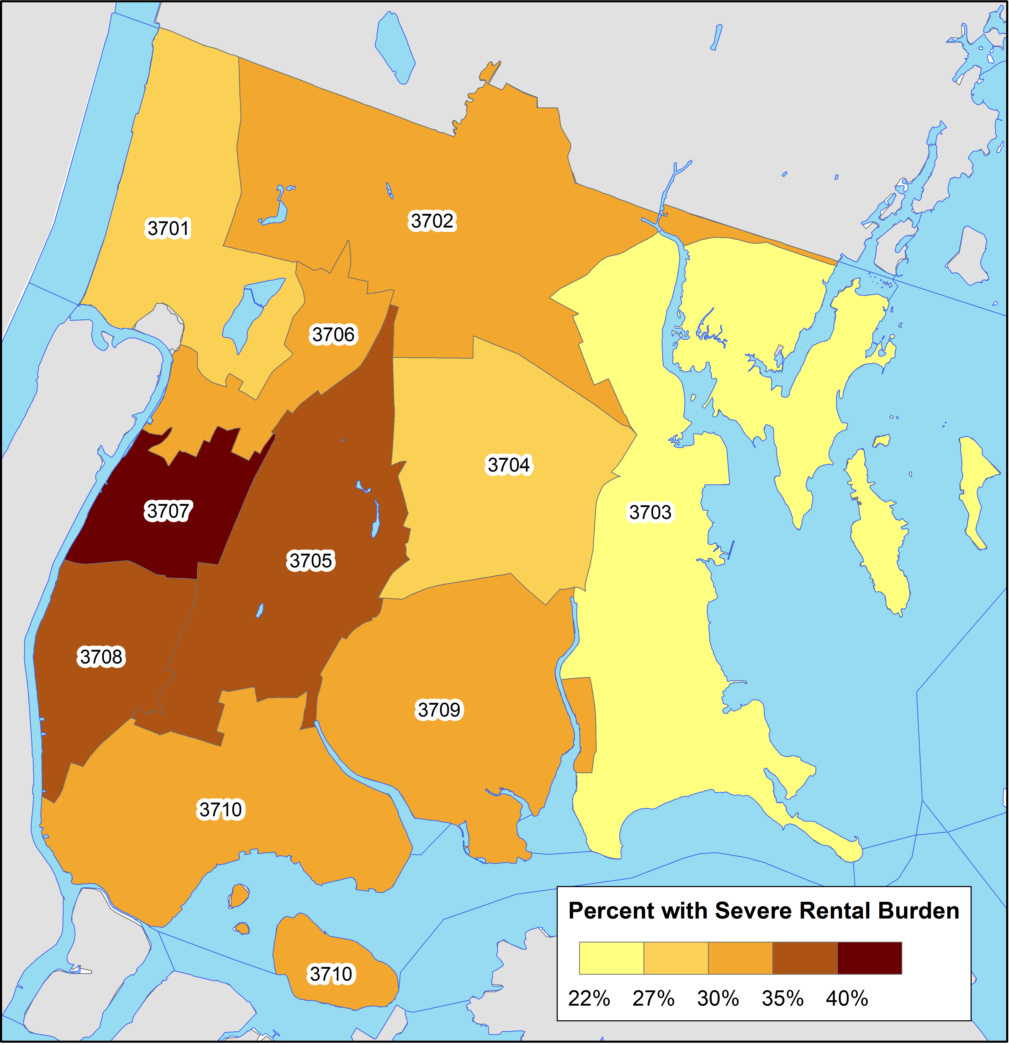
The percent of residents with severe rental burden varies across the Bronx
Severe rental burden defined as spending ≥50% of pre-tax household income on rent
PUMA (Approximate Community District)
Data source: American Community Survey Microdata obtained from IPUMS-USA, University of Minnesota: 2012-2016. PUMA stands for Public Use Microdata Area and is created by the US Census Bureau; they approximately correspond to NYC Community Districts. See https://www1.nyc.gov/assets/planning/download/pdf/data-maps/nyc-population/census2010/puma_cd_map.pdf for more information.

Slide 36
About the Community Health Dashboard Project
The goal of the project is to provide Bronx-specific data on risk factors and health outcomes with an emphasis on presenting data on trends, socio-demographic differences (e.g., by age, sex, race/ethnicity, etc.) and sub-county/neighborhood level data
Data will be periodically updated as new data becomes available.
Produced by Montefiore’s Office of Community & Population Health using publicly-available data sources
For more information please contact us at OCPHDept@montefiore.org

Slide 37
Links to data sources
New York City Child Health, Emotional Wellness and Development Survey: https://a816-healthpsi.nyc.gov/epiquery/Child/CCHSIndex.html
New York City Community Health Survey: https://a816-healthpsi.nyc.gov/epiquery/CHS/CHSXIndex.html
New York City Environment & Health Data Portal: http://a816-dohbesp.nyc.gov/IndicatorPublic/publictracking.aspx

